Slide 1


ADO .NET PROJECT
Submitted by
Sanjay M
Althaf S
Rachana K

Slide 2
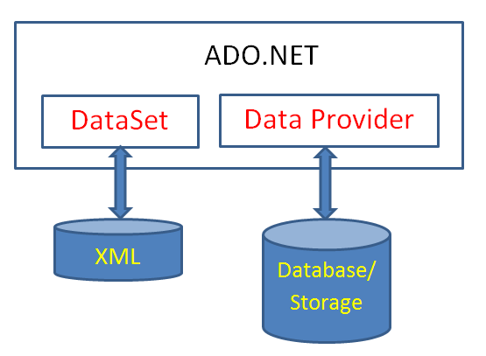
What is Ado .NET?
It is a module of .NET Framework which is used to
establish connection between application and data sources.
Data sources can be such as SQL Server and XML. ADO.NET consists of classes that can be used to connect, retrieve, insert and delete data.

Slide 3
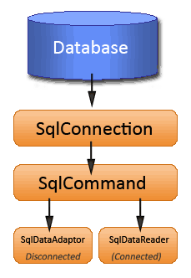
Introduction
Project Name:- Ado .NET Project
In our project we are having two tables and seven Forms as follows
Employee Table
Department Table
Forms,
Employee Insertion Form
Department Insertion Form
Get data by Emp_name Form
Get data by Emp_salary Form
Update employee data Form
Delete employee data Form
Retriving data using Innerjoin Form

Slide 4
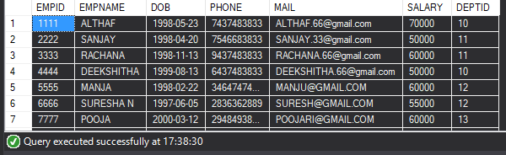
Employee table Overview
CREATE TABLE EMPLOYEE
(
EMPID INT PRIMARY KEY,
EMPNAME VARCHAR(50),
DOB DATE,
PHONE VARCHAR(50),
MAIL VARCHAR(50),
SALARY FLOAT,
DEPTID INT FOREIGN KEY REFERENCES DEPT(DEPTID)
);
INSERT INTO EMPLOYEE VALUES(1111,'ALTHAF','23-MAY-1998','7437483833','ALTHAF.66@gmail.com',70000,10);
INSERT INTO EMPLOYEE VALUES(2222,'SANJAY','20-APR-1998','7546683833','SANJAY.33@gmail.com',50000,11);
INSERT INTO EMPLOYEE VALUES(3333,'RACHANA','13-NOV-1998','9437483833','RACHANA.66@gmail.com',60000,11);
INSERT INTO EMPLOYEE VALUES(4444,'DEEKSHITHA','13-AUG-1999','6437483833','DEEKSHITHA.66@gmail.com',70000,10);
INSERTING VALUES
TABLE CREATION
TABLE RECORDS

Slide 5
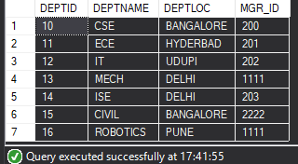
Department table Overview
CREATE TABLE DEPT
(
DEPTID INT PRIMARY KEY,
DEPTNAME VARCHAR(50),
DEPTLOC VARCHAR(50),
MGR_ID INT
);
INSERT INTO DEPT VALUES(10,'CSE','BANGALORE',200);
INSERT INTO DEPT VALUES(11,'ECE','HYDERBAD',201);
INSERT INTO DEPT VALUES(12,'IT','UDUPI',202);
INSERT INTO DEPT VALUES(13,'MECH','DELHI',1111);
INSERTING VALUES
TABLE CREATION
TABLE RECORDS

Slide 6

Total no. of Queries : 7
Q1-Q2 by – Rachana K
Q3-Q4 by – Althaf S
Q5-Q7 by – Sanjay M
Q7- By Team.

Slide 7
Insertion procedure for Employee table
CREATE PROCEDURE EMP_INSERT
(
@EMPID INT,
@EMPNAME VARCHAR(50),
@DOB DATE,
@PHONE VARCHAR(50),
@MAIL VARCHAR(50),
@SALARY FLOAT,
@DEPTID INT
)
AS
BEGIN
INSERT INTO EMPLOYEE VALUES(@EMPID,@EMPNAME,@DOB,@PHONE,@MAIL,@SALARY,@DEPTID);
END
PROCEDURE CODE

Slide 8
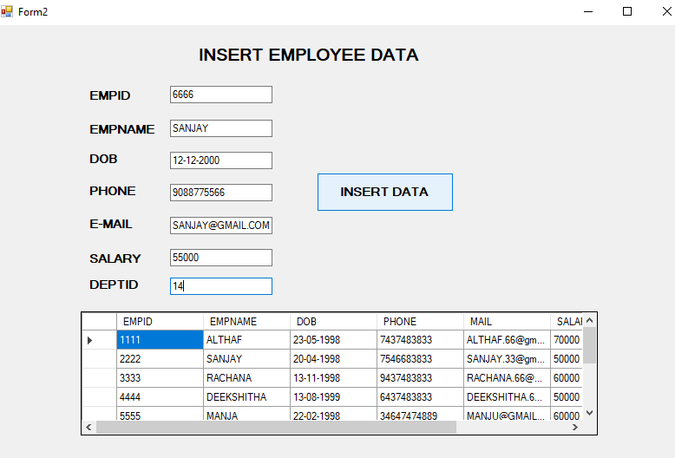
QUERY 1. WAQ TO INSERT EMPLOYEE DETAILS INTO EMPLOYEE TABLE USING EMP FORM.
OUTPUT :-

Slide 9
Insertion procedure for Department table
CREATE PROCEDURE DEPT_INSERT
(
@DEPTID INT,
@DEPTNAME VARCHAR(50),
@DEPTLOC VARCHAR(50),
@MGR_ID INT
)
AS
BEGIN
INSERT INTO DEPT VALUES(@DEPTID,@DEPTNAME,@DEPTLOC,@MGR_ID);
END
PROCEDURE CODE

Slide 10
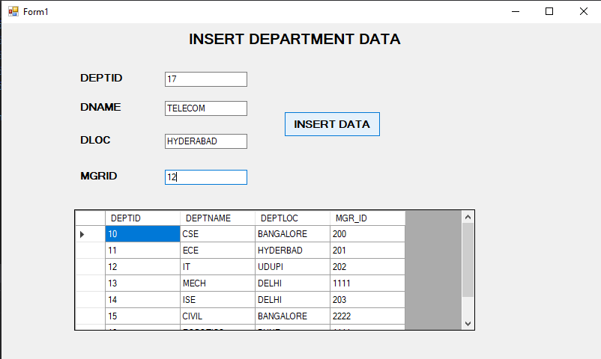
QUERY 2. WAQ TO INSERT DEPARTMENT DETAILS INTO DEPARTMENT TABLE USING EMP FORM.
OUTPUT :-

Slide 11
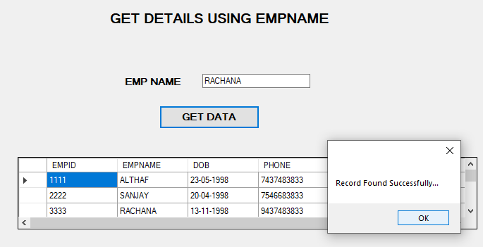
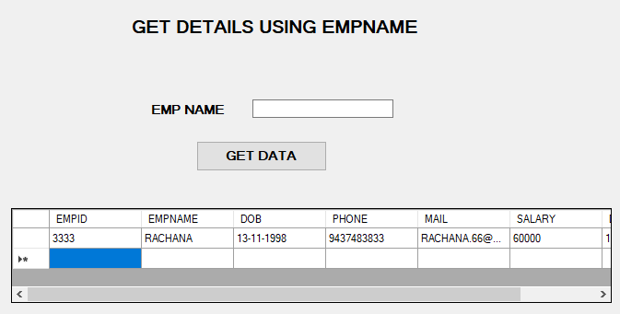
QUERY 3. WAQ TO SEARCH EMPLOYEE RECORD FROM EMPLOYEE TABLE USING EMP NAME THROUGH FORM.
QUERY :-
SELECT * FROM EMPLOYEE WHERE EMPNAME=‘RACHANA';
OUTPUT

Slide 12
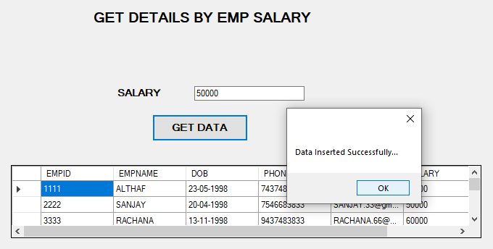
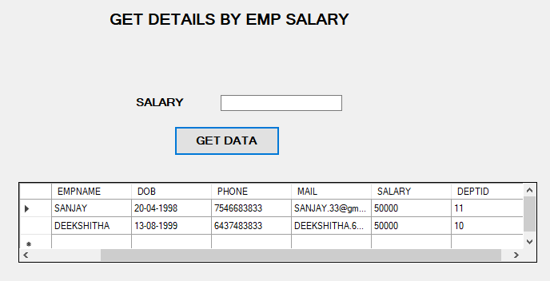
QUERY 4. WAQ TO SEARCH EMPLOYEE RECORD FROM EMPLOYEE TABLE USING EMP SALARY THROUGH FORM.
QUERY :-
SELECT * FROM EMPLOYEE WHERE SALARY=‘50000';
OUTPUT

Slide 13
Update procedure for Employee table
CREATE PROCEDURE EMP_UPDATE
(
@EMPID INT,
@EMPNAME VARCHAR(50),
@DOB DATETIME,
@PHONE VARCHAR(50),
@MAIL VARCHAR(50),
@SALARY FLOAT,
@DEPTID INT
)
AS
BEGIN
UPDATE EMPLOYEE SET EMPNAME=@EMPNAME,DOB=@DOB,PHONE=@PHONE,
MAIL=@MAIL,SALARY=@SALARY,DEPTID=@DEPTID WHERE EMPID=@EMPID;
END
PROCEDURE CODE

Slide 14
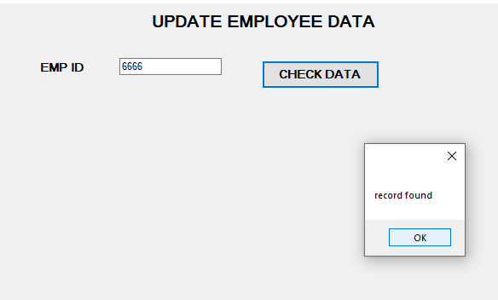
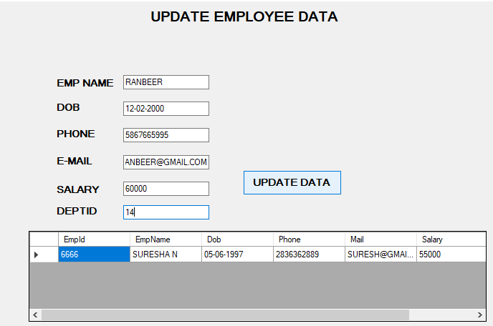
QUERY 5. WAQ TO UPDATE EMPLOYEE RECORD TO EMPLOYEE TABLE USING FORM.
SEARCH FOR EMP RECORD
INSERT THE UPDATED CONTENT

Slide 15
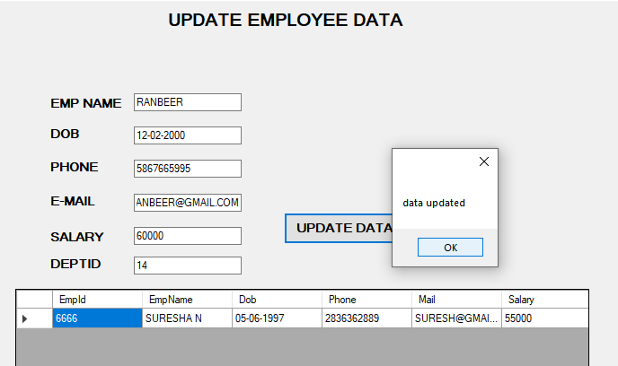
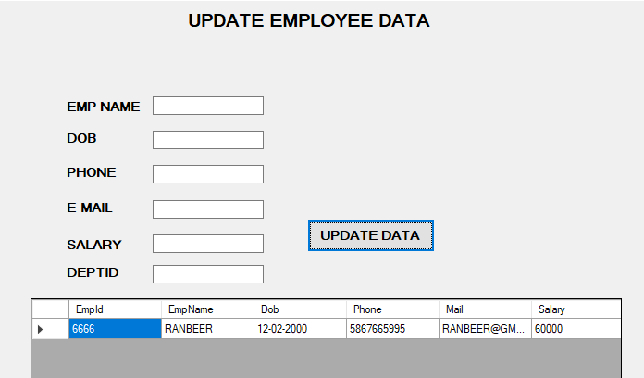
QUERY 5. WAQ TO UPDATE EMPLOYEE RECORD TO EMPLOYEE TABLE USING FORM.
UPDATED MESSAGE
VERIFING UPDATED RECORD

Slide 16
Delete procedure for Employee table
CREATE PROCEDURE EMP_DELETE(
@EMPID INT)
AS
BEGIN
DELETE FROM EMPLOYEE WHERE EMPID=@EMPID;
END
PROCEDURE CODE

Slide 17
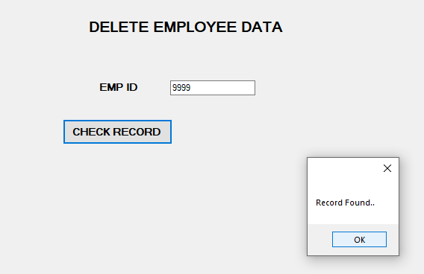
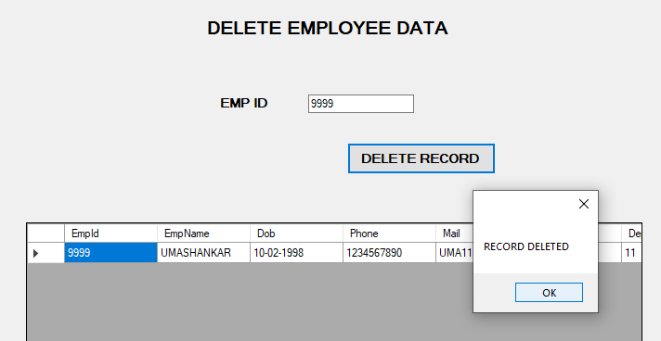
QUERY 6. WAQ TO DELETE A EMPLOYEE RECORD FROM EMPLOYEE TABLE USING FORM.
SEARCH FOR EMP RECORD
CLICK ON DELETE RECORD

Slide 18
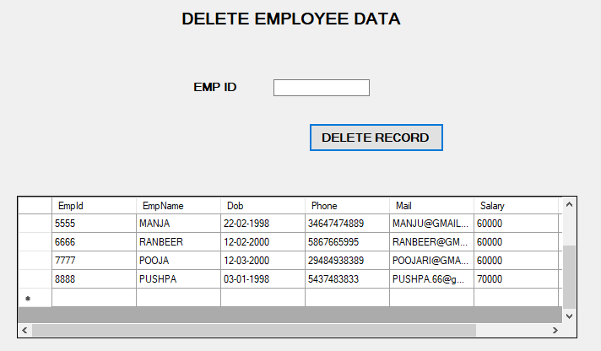
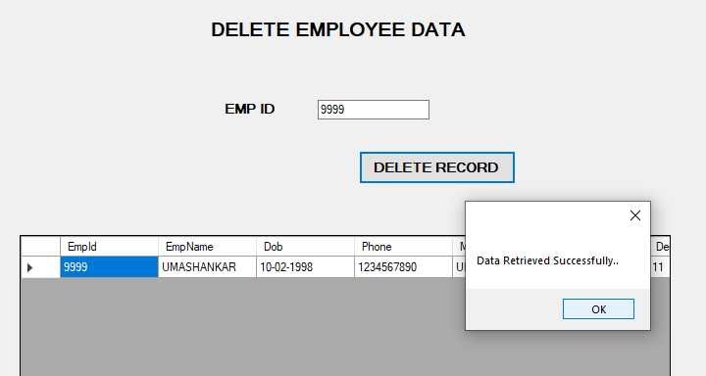
QUERY 6. WAQ TO DELETE A EMPLOYEE RECORD FROM EMPLOYEE TABLE USING FORM.
VERIFY RECORD DELETED OR NOT?

Slide 19
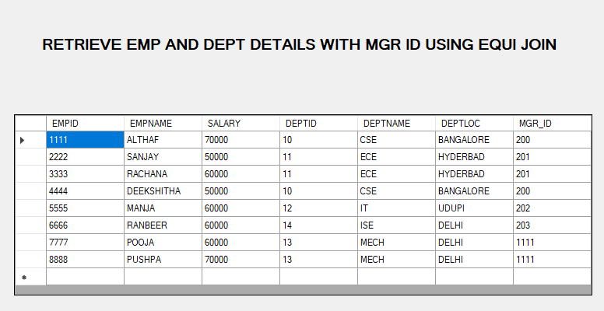
QUERY 7. WAQ TO FETCH THE DATA FROM EMPLOYEE AND DEPARTMENT TABLE USING INNERJOIN THROUGH FORM.
OUTPUT

Slide 20


